Slide 1
The Association of Cultural Interaction and Awareness
www.kefder.org
YOU.CO.DE YOUNG COMMUNITY DEVELOPERS
PALERMO(ITALY) 14-20 DECEMBER 2015

Slide 2
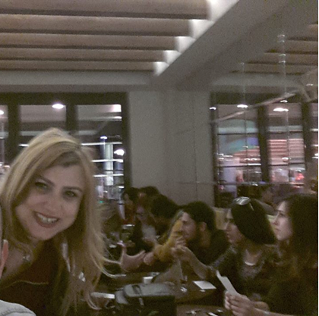
Emel Alay
Textile Engineer
Vice President
PhD. Student

Slide 3
WHO ARE WE?
We are ordinary people who wants to improve ourselves and our community
OUR AIM
Our aim is to make people aware of social, cultural , technical, economical matters by providing local, regional, national and international interaction and cooperating with associations, coorporations and institutions..

Slide 4
OUR MISSION
We want to set up awareness by using processes of cultural interaction in local, regional, national and international platforms.
OUR VISION
We want to be a non –governmental organization which is preferred internationally by the other organizations due to our social, cultural, economic activities.

Slide 5
OUR LOGO
LOCK: Our association works as a lock in cultural interaction. The open lock represents our tolerance to every idea.
GRAY: Objectiveness, modesty, making peace between individuals and groups.
COLOURFUL HEARTS: Different cultures.
YELLOW: Intellectual strength, the quality of mind, variety.
TURQUOISE: Turkish blue. Silence, eternity, vastness, tranquility, love of life.
ORANGE: Foresight, balance, optimism, liveliness, happiness.
THREE HEARTS: Our association holds the luck of three-leaved clover.
CLOVER’S STEM: Our association connects different colours and cultures under its umbrella. The end of the umbrella gets complete with the open lock.

Slide 6
WHY CULTURAL INTERACTION AND AWARENESS?
Cultural awareness is being aware of the values, beliefs and perceptions.
Communication tools are shaping up in an incredible speed, the variety between societies is noticed more today. Cultural interaction is gaining speed at the same rate. People living in different geographical lands, speaking different languages and having different religious and thoughts enjoy similar things now. This era expose a type of person who has his own cultural attitudes but also familiar with the other cultures in the world.
Contemporary person is expected to know much about his own culture and should know and respect charecteristics and values of the other cultures.
Making people have awareness about others will help them to respect and tolerate each other, set up emphathy, recognize the common problems and look for their solutions, perceive the cultural variety not as a problem but an advantage. For this reason, our association targets to work under this main topic.
We need to provide people with various processes of education to make them contemporary.
We think that aims to make people aware of their own and provide them an opportunity for learning during their lifetime will help them to live happily and peacefully.

Slide 7
Activities
Organizing educational work such as courses, seminars, conferences, panels, workshops, works of art, going to festivals, producing presentation materials, helping present products to get known by more people.
Organizing cultural trips, meetings, concerts, exhibitions and competitions for people at any age and having different jobs and helping people to make use of these activities.
Starting common projects with national and international foundations and institutions.

Slide 8
What we did?
Amateur Izmir English Conversation Club
İzmir Cultural Treasure Hunt
Izmir on Canvas by Our Young Guests Look
Awareness Talks

Slide 9
Amateur Izmir English Conversation Club

Slide 10
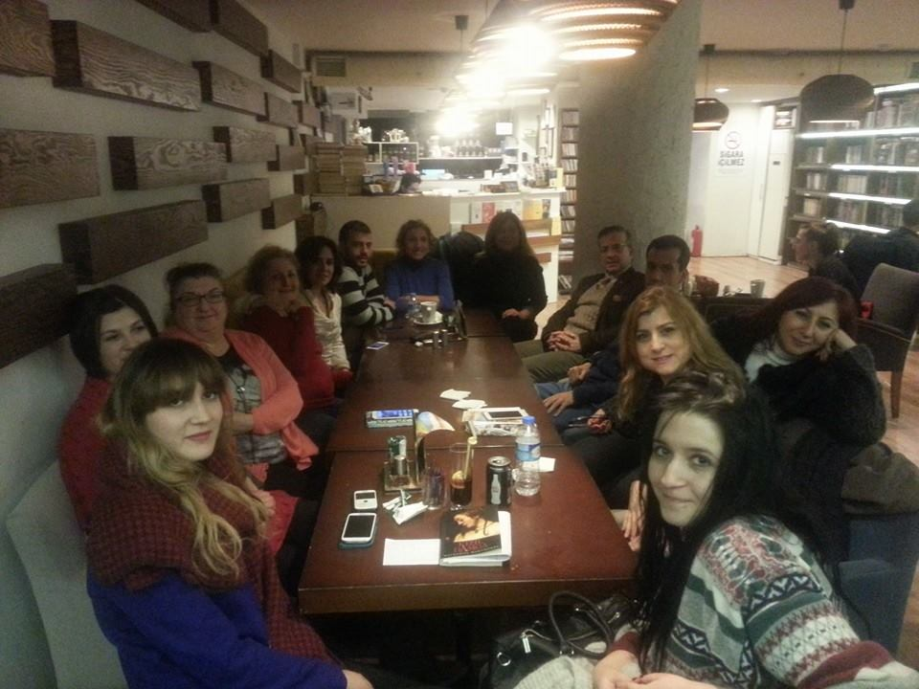
Awareness Talks

Slide 12
İZMİR ON CANVAS BY OUR YOUNG GUESTS' LOOK
Activity Coordinator: Cultural Interaction and Awareness Association(Kefder)
The Aim Of The Activity : The aim of the activity is to introduce cultural and historical heritage of Izmir to the young who come from abroad and another city of Turkey to our city. In addition, Kefder would like to provide opportunity presenting their perceptions related with our city through art and provide interaction sharing these artistic values with our citizens.
Target Group Of The Activity: Totally 40 volunteer young who comes from abroad via Erasmus Programme,… etc. or other cities of Turkey to Izmir.

Slide 13
Programme of the activity
Cultural Tresuare Hunt Of Izmir
Participants discovered main features of Izmir over the game.
Painting Performance Activity in Kültürpark(Izmir Fair)
Street party (several music and dance groups and food&beverage service ) organized during activity. Experts assisted participants while they were doing their performance.
Cocktail,Concert and Opening Ceremony of Exhibition in State Art and Sculpture Museum in Kültürpark (Izmir Fair)
The exhibition was visited during one week
The paintings were gave as a gift to the participants at the end of the exhibition.

Slide 17
Thanks for kind attention ☺

